Slide 1
Feature Engineering Using Snowflake
Submitted By- Arushi Mallick

Slide 2
What is Feature Engineering?
Feature Engineering is the process of selecting, creating or modifying features like input variables or data to help machine learning models learn patterns more effectively.
It involves transforming raw data into meaningful inputs that improve model accuracy and performance.
Feature engineering preprocesses raw data into a machine-readable format.
It optimizes ML model performance by transforming and selecting relevant features.

Slide 3
Importance of Feature Engineering
Improve accuracy:
  Choosing the right features helps the model learn better, leading to more accurate predictions.
Reduce overfitting:
  Using fewer, more important features helps the model avoid memorizing the data and perform better on new data.
Boost interpretability:
  Well-chosen features make it easier to understand how the model makes its predictions.
Enhance efficiency:
  Focusing on key features speeds up the model’s training and prediction process, saving time and resources.

Slide 4
Feature Engineering techniques
Feature Creation: It involves generating new features from existing data to highlight hidden patterns.
Feature Transformation: It applies mathematical modifications to features to improve model performance or reduce skew. Examples include encoding log transformation, normalization, and binning.
Feature Extraction: It reduces data dimensionality by converting raw data into a smaller set of informative features. Techniques include PCA for numerical data and embeddings for text/images.
Feature Selection: It chooses the most relevant features and removes irrelevant or redundant ones. It improves model accuracy, reduces overfitting, and speeds up training.
Feature Scaling: It standardizes the range of independent variables so no feature dominates others. Common methods include Min-Max scaling and Standardization.

Slide 5
Feature Creation
Feature Creation is the process of generating new, meaningful features from the existing raw data to help machine learning models learn patterns more effectively.
Types of Feature Creation:
Mathematical Combinations: Creating new features using arithmetic operations.
Data & Time-driven: Extracting date and time components to improve forecasting or classification.
Domain-Specific Feature Creation: Using expert knowledge to create meaningful variables.

Slide 6
Feature Transformation
Feature Transformation is the process of modifying or converting existing features into a format that helps a machine learning model learn patterns more effectively.Transformations improve data quality, reduce skewness, make features comparable, and help algorithms converge faster.
Normalization & Scaling: Normalization scales each data sample such that its vector length is 1.
Standardization: Standardization centers features by subtracting the mean and scales them by dividing by the standard deviation, transforming features to have zero mean and unit variance.
Encoding: Encoding transforms non-numerical categorical data into numerical forms so ML models can understand them. Types of encoding:
    Label Encoding: Assigns each category an integer value
    One-Hot Encoding: Creates a new binary column for each category
    Ordinal Encoding: Assigns values based on meaningful order
Mathematical Transformations: These transformations modify the distribution of data to remove skewness or improve linearity. These include Log Transformation, Square-Root Transformation, Binning, etc.

Slide 7
Feature Extraction
Feature Extraction is the process of reducing raw data into a smaller set of informative, meaningful features. Instead of working with the original high-dimensional data, the most important characteristics are extracted that help the machine learning model learn efficiently.
Dimensionality reduction: Dimensionality reduction techniques compress high-dimensional data into fewer features while retaining the most important patterns Techniques like PCA, LDA reduce features while preserving important information.
Aggregation & Combination: Aggregation methods create simpler, higher-level features by combining multiple raw features.

Slide 8
Feature Selection
Feature Selection is the process of choosing a subset of the most relevant features from the dataset.
Its goal is to remove irrelevant, redundant, or noisy features to improve model accuracy, reduce overfitting, and speed up computation. It does not create new features, it only selects the best ones.
Filter methods: Based on statistical measures like correlation.
Wrapper methods: Select based on model performance.
Embedded methods: Feature selection integrated within model training.

Slide 9
Feature Scaling
Feature Scaling is the process of transforming numerical features so they share a similar range or distribution. It ensures that no feature dominates others due to larger magnitude, which helps models converge faster and perform better especially distance-based models like KNN, SVM, and gradient descent-based algorithms.
Min–Max Scaling (Normalization): Min–Max scaling rescales feature values to a fixed range, typically 0 to 1.
Standard scaling: Normalizes to have a mean of 0 and variance of 1.

Slide 10
STORING DATA in Snowflake
Snowflake is a cloud-based data warehouse that supports both structured and semi-structured data using its unique storage architecture.
Snowflake stores structured data in traditional, optimized relational tables and semi-structured data (like JSON, Avro, XML) within a flexible VARIANT data type, often in a single column, allowing for schema-on-read querying with standard SQL.
Data is automatically compressed, encrypted, and divided into micro-partitions, with metadata tracking locations, making it efficient for both types; users can query semi-structured data directly or transform it into structured formats as needed, combining it seamlessly with relational data for powerful analytics.

Slide 11
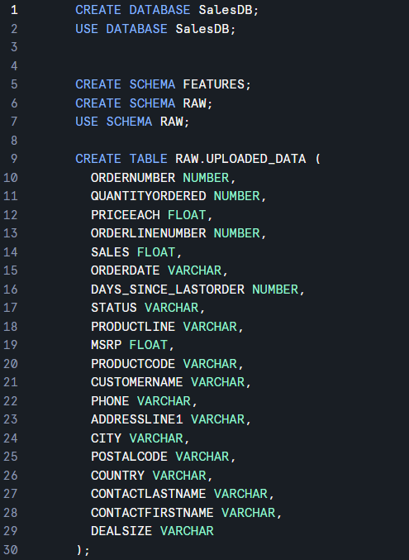
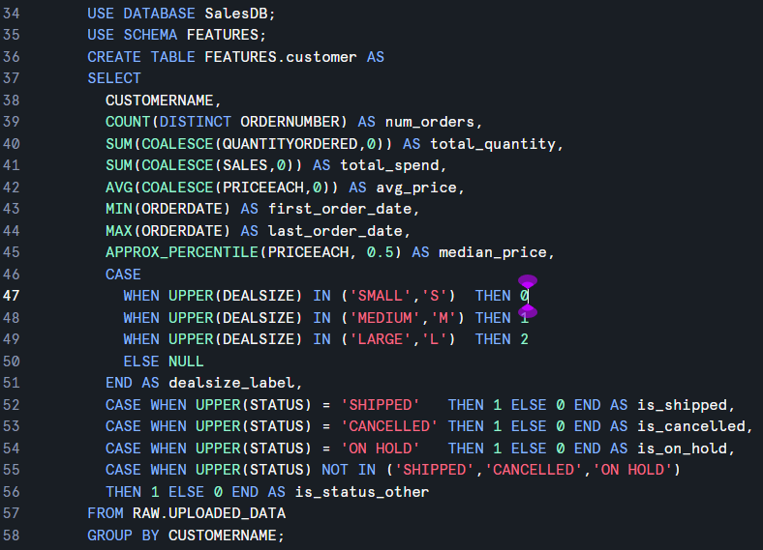
SQL with Snowflake
Data Set: Automobile Sales Data from Kaggle
Code to setup database and tables
Query with aggregations and encoding

Slide 12
ML Pipelines in Snowflake
Connects easily with tools like AWS SageMaker, Azure ML, Databricks, and Python notebooks for model training.
With Snowpark, UDFs, and external ML tools like SageMaker or Vertex AI, Snowflake enables seamless model training and deployment.
It also supports MLOps through tasks, streams, and feature store capabilities, allowing scalable, secure, end-to-end ML workflows.

Slide 13
Feature Store
A Feature Store is a centralized system used to store, manage, and serve ML-ready features for both model training and real-time predictions.
why is it needed?
Ensures the same feature logic is used in both training and production.
It ensures that feature definitions are consistent, reusable, and version-controlled.
Helps with tracking, versioning, monitoring, and managing feature metadata.

